Slide 1
Temporal Evolution-Aware
Fake News Detection
Using Heterogeneous Information Networks
Social and Information Networks — Group Project
Hridey Agarwal · Piyush Mahajan · Ridhima Garg
Datasets: PolitiFact & GossipCop | Models: HGAT + Temporal-HGAT (LSTM)

Slide 2
Problem & Motivation
Fake news spreads faster than corrections — millions are exposed before debunking can occur
Lifecycle of Fake News
Publication
Traditional text-only models are vulnerable to convincingly-written misinformation
Early spread, few fact-checkers
Viral Peak
Existing graph models treat detection as a one-shot task, ignoring temporal dynamics
Millions exposed, beliefs formed
No widely-used benchmark explicitly models credibility evolution over time
Fact-Check
Debunked — but damage done

Slide 3
Background & Research Gaps
Text-only Detection
Static Graph Models
Class Imbalance
Traditional methods rely solely on textual content and are easily fooled by convincingly-written fake articles
Existing graph models treat detection as a one-shot task, completely ignoring the temporal dynamics of how news spreads
GossipCop has a ~10:1 real-to-fake ratio — high accuracy can conceal very poor fake-class detection performance
Our Research Question: How can we model the changing nature of news over time using HINs to improve fake news detection?

Slide 4
Datasets
🏛 PolitiFact
📰 GossipCop
Domain: Politics & Policy
Size: ~900 articles
Class balance: Balanced (real/fake ≈ 1:1)
Strong URL-domain signal — misinformation clusters around low-credibility publishers
Leakage-free temporal partition using train-set quantiles only
Domain: Entertainment & Celebrity
Size: ~22,000 articles
Class balance: Highly Imbalanced (real >> fake, ~10:1)
Challenges recall on the minority fake class
High accuracy can mask very poor F1 for fake detection

Slide 5
HGAT Model — Two-Level Attention
Node-Level Attention
Schema-Level Attention
Each news article aggregates information from Creator and Subject neighbour nodes
A shared attention vector assigns importance weights per neighbour
LeakyReLU non-linearity applied for numerical stability
Produces a separate aggregated vector per neighbour type
Learns a weighted combination across neighbour types (Creator vs Subject)
Determines which node type is most discriminative per article
Produces a single unified article embedding
Final MLP classifier: Adam lr=0.005, dropout, 200 epochs
→

Slide 6
Static HGAT Results
PolitiFact Dataset
GossipCop Dataset
Train % | Accuracy | F1 | Precision | Recall
20% | 0.7896 | 0.7063 | 0.8231 | 0.6185
40% | 0.8391 | 0.7773 | 0.8900 | 0.6899
60% | 0.8208 | 0.7654 | 0.8267 | 0.7126
80% | 0.8679 | 0.8250 | 0.9167 | 0.7500
Train % | Accuracy | F1 | Precision | Recall
20% | 0.8463 | 0.6015 | 0.7986 | 0.4824
40% | 0.7980 | 0.2846 | 0.9570 | 0.1672
60% | 0.8498 | 0.6380 | 0.7581 | 0.5508
80% | 0.8383 | 0.5558 | 0.8175 | 0.4211
PolitiFact Highlights
⚠ GossipCop: F1 Collapse at 40% Split
Best Accuracy: 86.79% at 80% training split
URL domains proved a strong political credibility signal
F1 improves consistently with more training data
F1 = 0.285 despite 95.7% Precision
Recall collapsed to 0.167
Root cause: mini-batch sampling bias on imbalanced data

Slide 7
Class Imbalance Analysis & Mitigation
Key Insight: On GossipCop 40% split, Accuracy = 79.8% but F1 = 0.285 — the model predicted 'real' for nearly everything. High accuracy conceals poor fake detection.
Weighted Cross-Entropy
SMOTE Oversampling
Full-Graph Training
Up-weights the fake class proportional to class ratio. Improved recall at 40% split without sacrificing precision.
Synthetic minority-class samples generated in TF-IDF feature space. Balanced training batches, improved F1 consistency.
Eliminates mini-batch sampling bias (as in original paper). Most effective — yields consistent F1 across all GossipCop splits.
F1: 0.285 → 0.451
F1: 0.285 → 0.492
F1: 0.285 → 0.589 ✓ Best
Temporal-HGAT alone recovers F1 from 0.285 → 0.521 at the 40% GossipCop split, demonstrating temporal context as a strong imbalance mitigation tool.

Slide 8
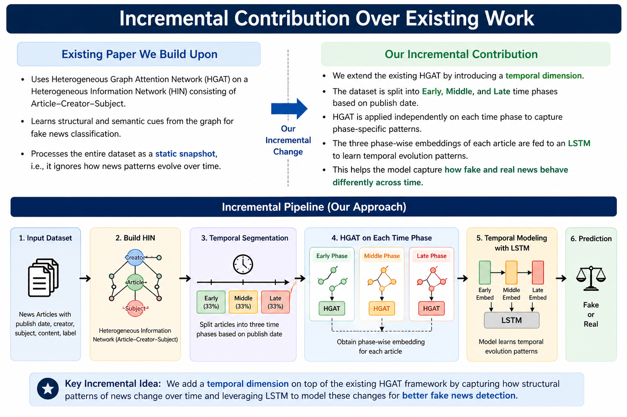

Slide 9
System Architecture: Temporal-HGAT
1
2
3
4
5
6
Data
Preprocessing
→
HIN
Construction
→
HGAT
Model
→
Temporal
Snapshots
→
LSTM
Sequencing
→
Fake/Real
Classifier
TF-IDF, URL domains, keywords
News · Creator · Subject nodes
Node + Schema Attention
Early · Middle · Late
Temporal sequence → hidden state
MLP + Dropout
Heterogeneous Information Network (HIN)
Temporal Partitioning (Leakage-Free)
📄 News Article nodes → TF-IDF (3,000 features)
Early Snapshot (0–33rd %ile)
🌐 Creator nodes → URL domain char n-grams (500 feat.)
Middle Snapshot (33–67th %ile)
🏷 Subject nodes → Top-3 TF-IDF keywords (100 feat.)
Edges: creator → article ('publishes')
Late Snapshot (67–100th %ile)
Edges: article → subject ('topic_of')
Bin boundaries computed from TRAIN quantiles only → No data leakage

Slide 10
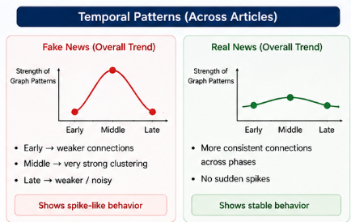
Core Novelty — Temporal-HGAT
Step 1
Step 2
Step 3
Temporal Partitioning
Per-Snapshot HGAT
LSTM Temporal Model
Corpus split into 3 snapshots by publication timestamp:
Early (T1) · Middle (T2) · Late (T3)
Bin boundaries derived from train-set quantiles only to prevent data leakage.
An independent HGAT is trained on each temporal snapshot, producing 3 distinct embedding vectors per article capturing how the graph context evolves over time.
The ordered sequence [T1, T2, T3] is fed into an LSTM. The final hidden state is passed to an MLP classification head for fake/real prediction.
How Temporal-HGAT Works
Step 1: HGAT (per phase)
Learns important creators, topics, and connections
Creates a representation of each article
Step 2: LSTM
Input: Early → Middle → Late
Learns how patterns change across phases
Fake news → irregular patterns
Real news → stable patterns
Key Insight: Fake news is not static — We model how the context around news articles changes across different time phases.. LSTM captures this temporal arc.

Slide 11
Temporal-HGAT Results
PolitiFact — Static vs Temporal HGAT
GossipCop — Static vs Temporal HGAT
Train% | Static Acc | Temp Acc | ΔAcc | ΔF1
20% | 0.7896 | 0.8104 | +0.021 | 0.706 → 0.731
40% | 0.8391 | 0.8567 | +0.018 | 0.777 → 0.803
60% | 0.8208 | 0.8423 | +0.022 | 0.765 → 0.789
80% | 0.8679 | 0.8850 | +0.017 | 0.825 → 0.852
Train% | Static Acc | Temp Acc | ΔAcc | ΔF1
20% | 0.8463 | 0.8601 | +0.014 | 0.601 → 0.640
40% | 0.7980 | 0.8312 | +0.033 | 0.285 → 0.521 ↑↑
60% | 0.8498 | 0.8674 | +0.018 | 0.638 → 0.689
80% | 0.8383 | 0.8521 | +0.014 | 0.556 → 0.618
Temporal-HGAT Architecture Flow
Early
HGAT
Middle
HGAT
Late
HGAT
LSTM
Sequencer
MLP
Classifier
Fake /
Real
→
→
→
→
→
Temporal-HGAT consistently outperforms Static HGAT across all splits on both datasets, with the largest F1 recovery on GossipCop (+82.8% relative at 40% split).

Slide 12
Limitations
Approximate Temporal Modeling
Simplified Heterogeneous Graph
Limited Feature Richness
The same article is not tracked over time. Instead, the dataset is divided into temporal phases — this is time-based grouping, not true evolution tracking.
Limited node types: Creators approximated from URL only, Subjects from TF-IDF. The HIN does not include users, comments, or social interactions.
The model relies primarily on TF-IDF bag-of-words features with no deep semantic understanding of article content.
No Propagation / User Behavior
Dataset Constraints
Scalability
No sharing, retweet, or engagement data. Missing real news spreading dynamics which are highly informative for fake news detection.
Lack of explicit temporal metadata and repeated time observations forces approximations that limit the quality of the temporal model.
Training separate HGAT models for each temporal snapshot significantly increases computational cost, especially for large graphs.

Slide 13
Future Work & Extensions
True Temporal Modeling
Full Heterogeneous Graph
Advanced Text Embeddings
Track articles with real timestamps over time. Model same-article updates and engagement timelines rather than dataset-level segmentation.
Add Users, Comments, Publishers, and Social Network nodes. Include edges: user shares article, user comments, article influences another.
Replace TF-IDF with BERT or RoBERTa for deep semantic understanding of article language and contextual meaning.
Propagation Modeling
End-to-End Temporal HGAT
Real-Time Detection
Apply diffusion and cascade models to capture how fake news spreads through social networks — the viral dynamics often distinguish fake from real.
Instead of separate HGAT per snapshot, adopt dynamic graph neural networks for unified, computationally efficient temporal modeling.
Extend the model to detect fake news as it spreads in real time. Evaluate on LIAR and FakeNewsNet with live user engagement data.

Slide 14
Conclusion
HGAT reproduced and validated: up to 86.79% accuracy on PolitiFact and 84.98% on GossipCop
Temporal-HGAT: leakage-free temporal partitioning + per-snapshot HGAT embedders + LSTM sequencer — consistent gains across all splits on both datasets
Class imbalance exposed and addressed: weighted cross-entropy, SMOTE, and full-graph training evaluated — full-graph training most effective
Temporal signal analysis: Late snapshot dominates PolitiFact (credibility emerges post-sharing); Early snapshot dominates GossipCop (viral spreading is primary signal)
Graph-structural features are effective even from lightweight URL-domain proxies, showing promise for scalable fake news detection
Thank You

